Slide 1

Mental Health: Statistical Analysis
Mridul Gupta | Vardaan Bhatia | Prem Patel

Slide 2



THE TEAM
Vardaan Bhatia
Mridul Gupta
Prem Patel

Slide 3

Introduction
Domain of Interest : Mental Health
Mental disorders significantly affects an individual’s ability and hampers their Thinking, Emotional Regulation, or Behavioral natures.
Notes:
As per WHO statistics, 1/8 people in the world is suffering from a mental disorder. Mental disorders significantly affects an individual’s ability and hampers their thinking, emotional regulation, or behavioral natures.

Slide 4
Guiding questions
Is there any relationship between the depression levels in Males and Females?
What sort of depression trends can we see across different age groups?
Does there exists any relationship between a person’s education level and depression percentage
Does suicide rates and depressive disorder rates have any correlation
What kind of relationship exists between Anxiety and Depression
Is the mean of the affected population percentage for the chosen country is equal to the overall population mean for depression?

Slide 5
DATASET
TABLE NAME | DESCRIPTION
Prevalence By Mental Illness and substance | Contains data for different types of mental disorders
Prevalence of depression by Age | The data in this table is bifurcated across various age groups
Depression by level of education | Possesses data for different education levels in the society such as Upper Secondary and Post-Secondary etc.
Suicide Rates | Contains data for the suicide rates across various regions along with depressive disorder rates compared to the entire population
Depression by Count | Contains the number of people suffering from mental disorders across regions by year
Depression by Gender | Data in this table provides the distribution of people suffering from mental disorders by gender type across regions

Slide 6
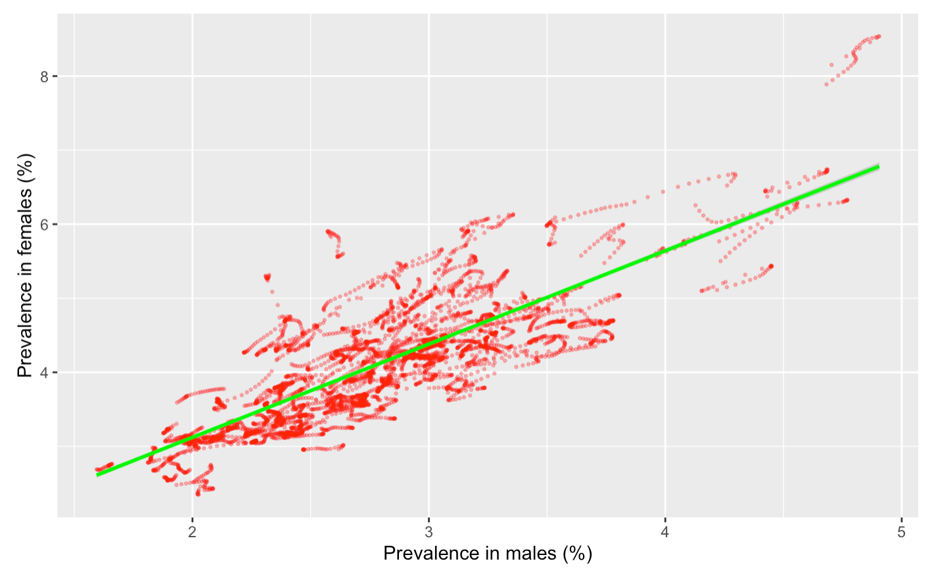
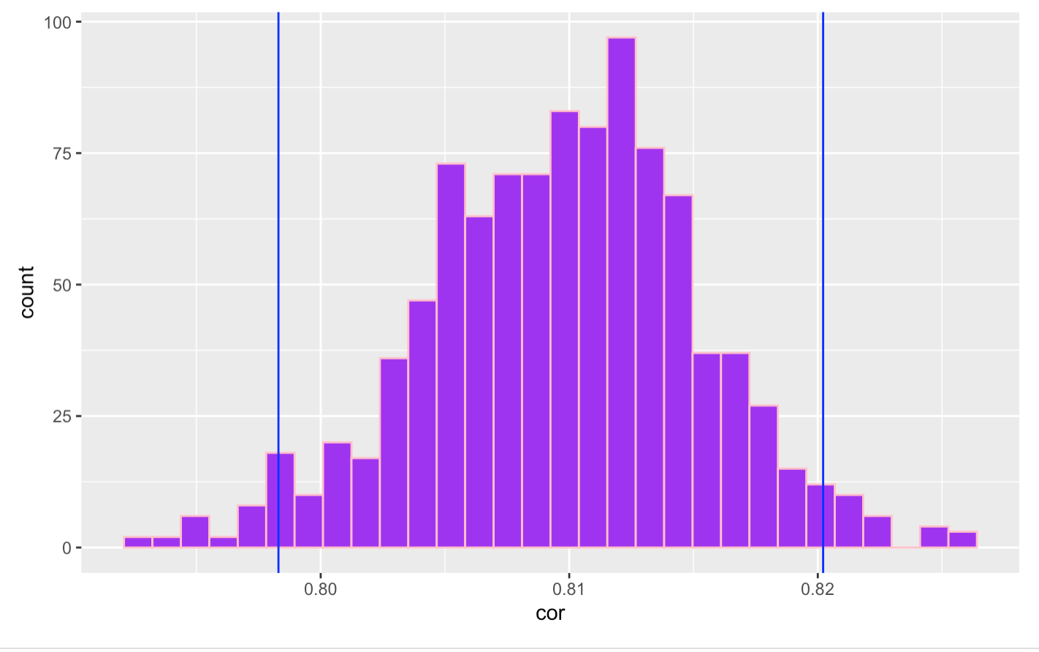
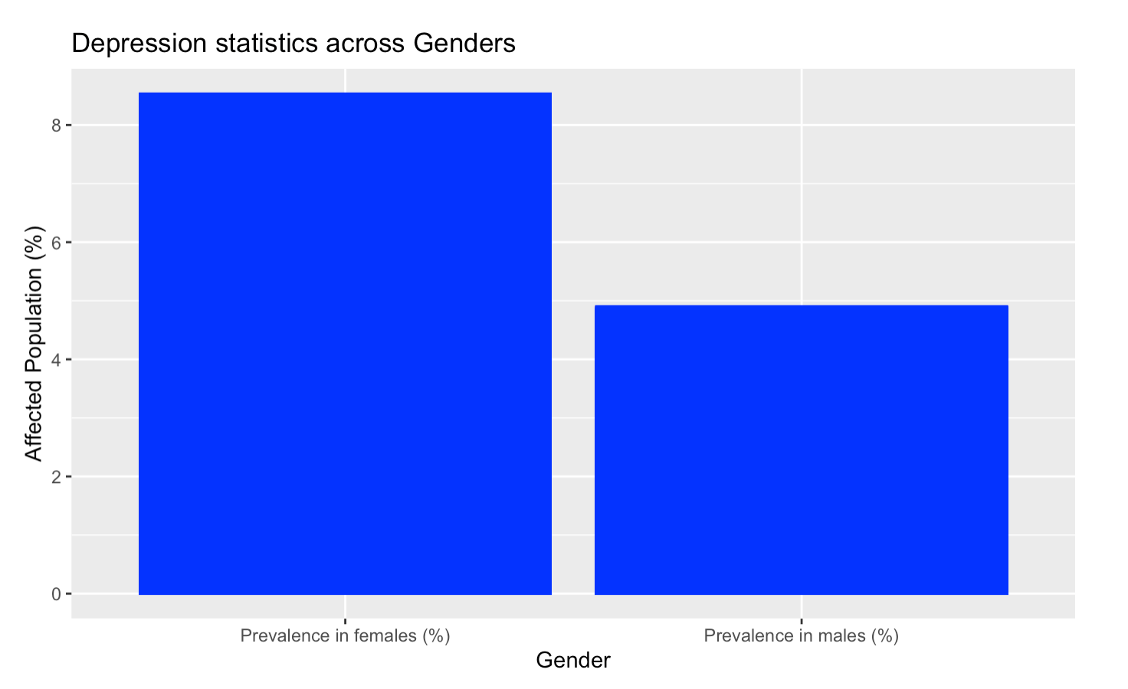
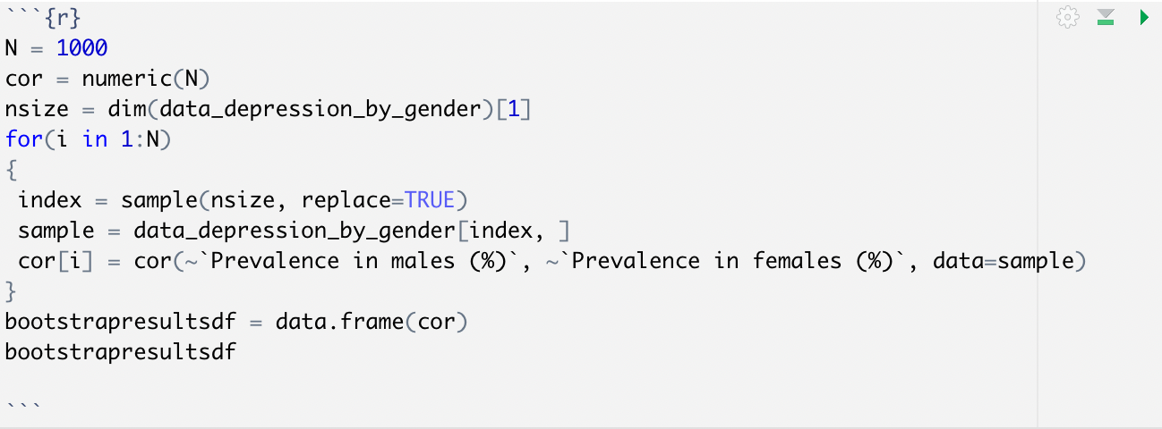
Is there any relationship between the depression levels in Males and Females?
Notes:
H0:B=0(Y cannot be expressed as a linear functionof X)
HA:B≠0(Y can be expressed as a linear function of X)
Based on the results of the F test - The p value for the given data distribution is close to 0, therefore we can reject the null hypotheses. In the context of the data of Males vs Females ddepression rates, the data is linear.
Such a low p-value indicates that the null hypothesis cannot be supported which signifies that there exists a linear relationship between the depression levels of Males and Females
---------------------
In this section of the study, we ran a bootstrap model to calculate the correlation index between the data for the two genders and plotted then over a histogram. We also infer that with a 95% confidence interval, the value of the correlation index is between the range of 0.798 and 0.820, which depicts a strong correlation between the two parameters.

Slide 7
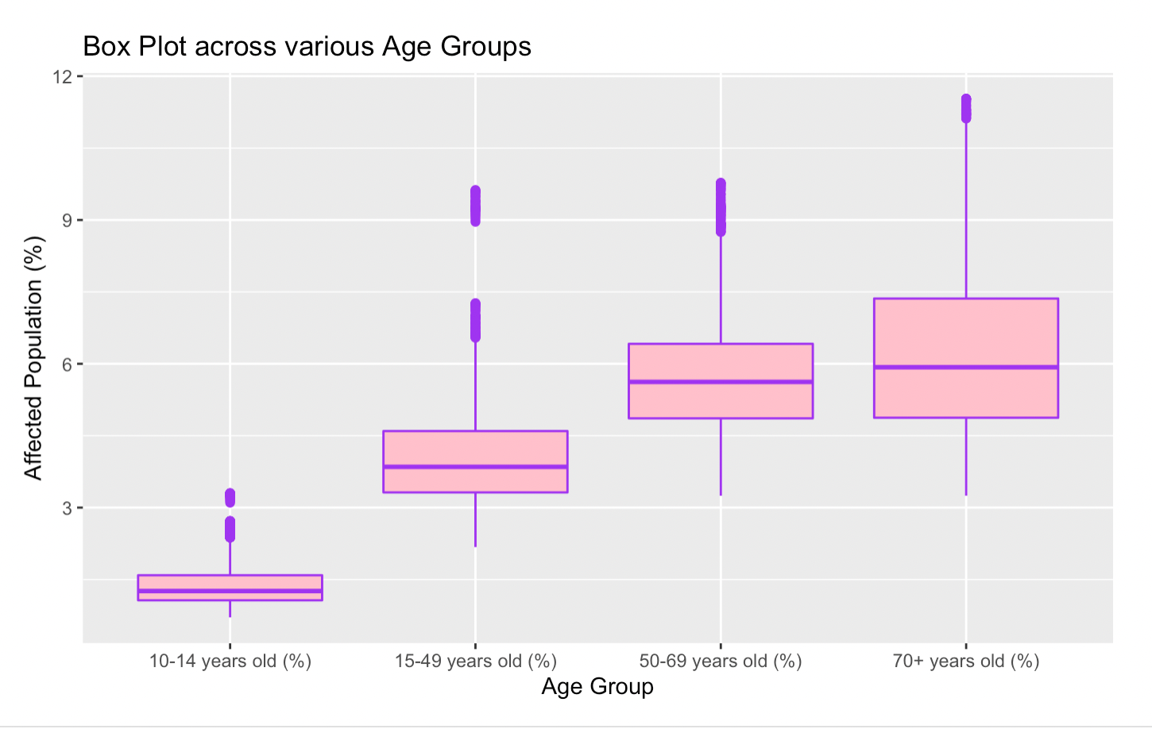
What sort of depression trends can we see across different age groups?
Notes:
The above graph visualizes how the depression percentage varies in the overall population across various age groups. From this, we infer that with the increase in ages, a person falling into different age groups, the depression level increases

Slide 8
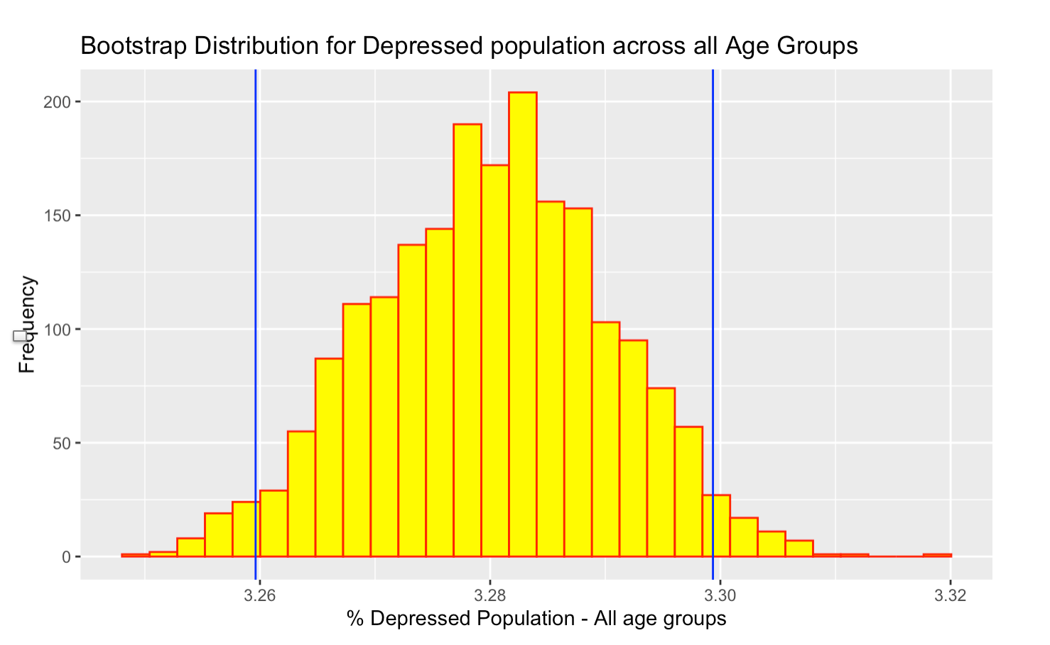
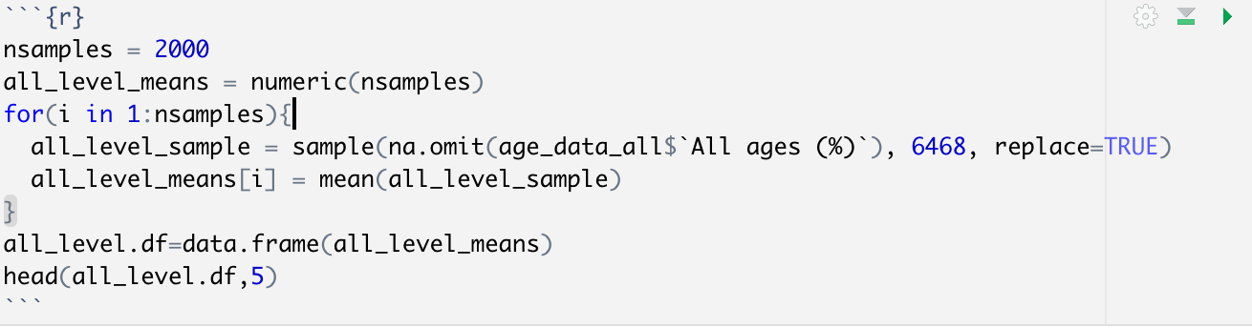
What sort of depression trends can we see across different age groups?
H0: There is no relationship between Depression percentages and Age Group
H0: There is a relationship between Depression percentages and Age Group
Notes:
Since the p value is close to zero, it can concluded that the null hypotheses fails. Therefore there is a relationship between the Age Group and the Depression Percentages of the population
we run a bootstrap statistic to determine the overall mean affected depression percentage across all age group levels. We infer from the above graph that with a 95% confidence, the mean of the affected depression percentage lies between the range 3.258 and 3.300 percent

Slide 9
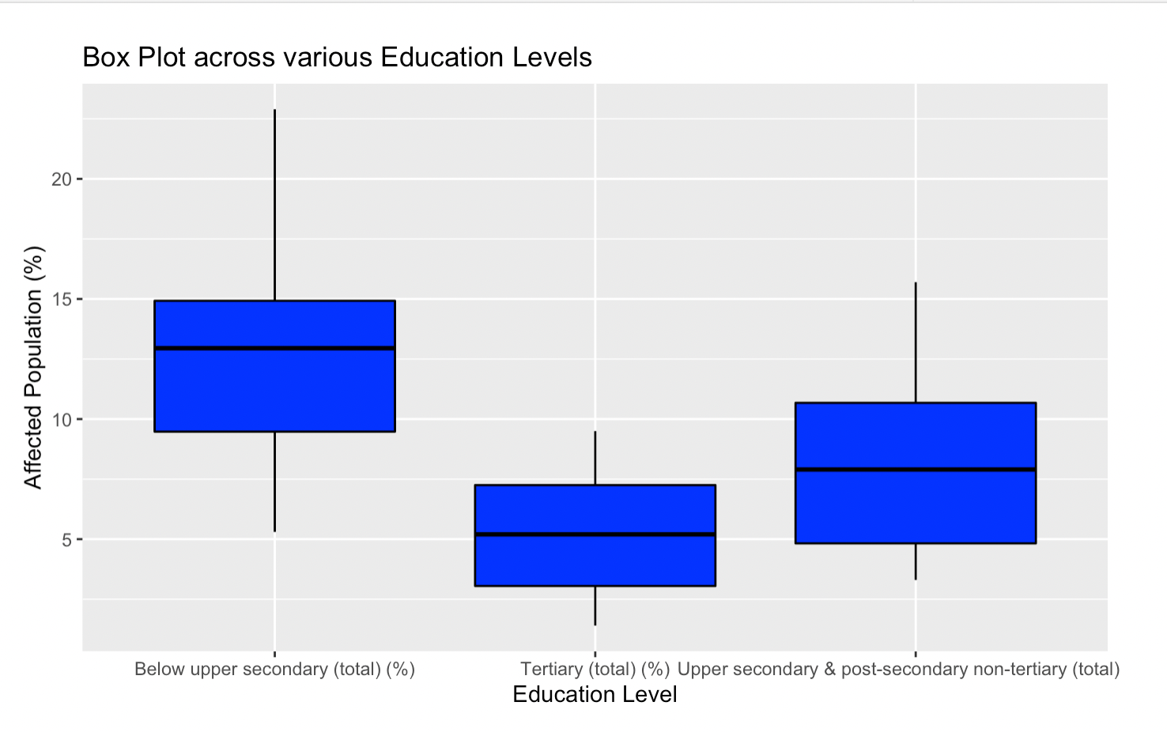
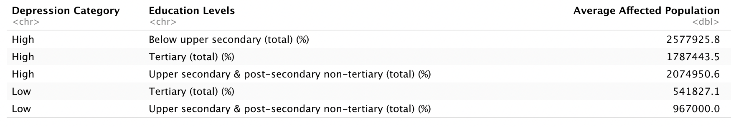
Does there exist any relationship between a person’s education level and depression percentage
Notes:
Pearson's Chi-squared test data:
education_levels.df X-squared = 956193, df = 2, p-value < 2.2e-16
Since the p value is close to zero, it can concluded that the null hypotheses fails. Therefore there is a relationship between the Education Levels and the Depression Percentages of the population.

Slide 10
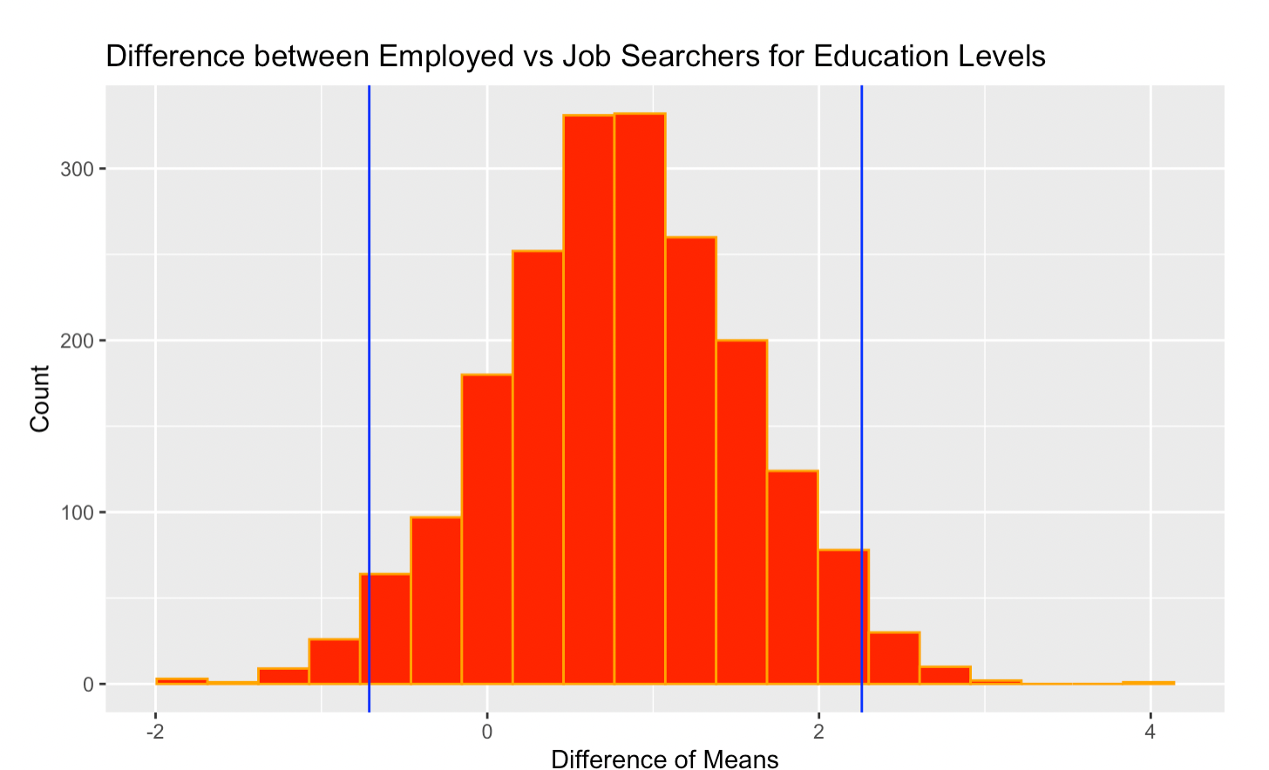
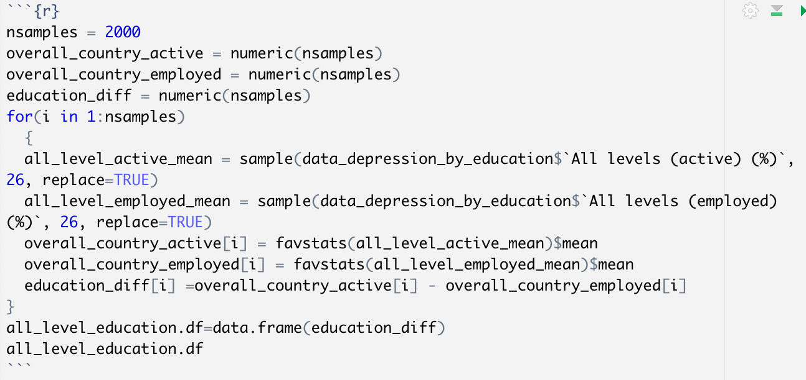
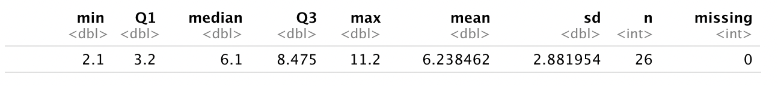
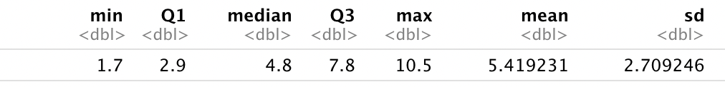
Does there exist any relationship between a person’s education level and depression percentage
Notes:
Pearson's Chi-squared test data:
Since the p value is close to zero, and we can see a positive difference between JobSeeker-Employed. It can be concluded that the null hypotheses fails. Therefore there is a relationship between the Education Levels and the Depression Percentages of the population.
95%. Conf Intv : -0.654 , 2.32

Slide 11
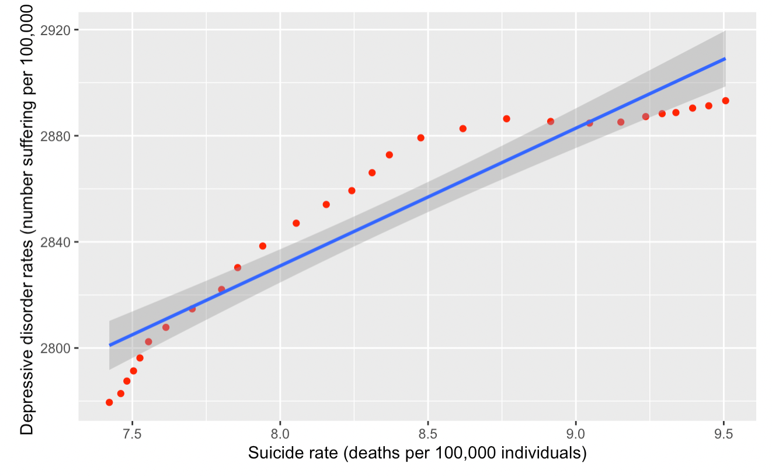
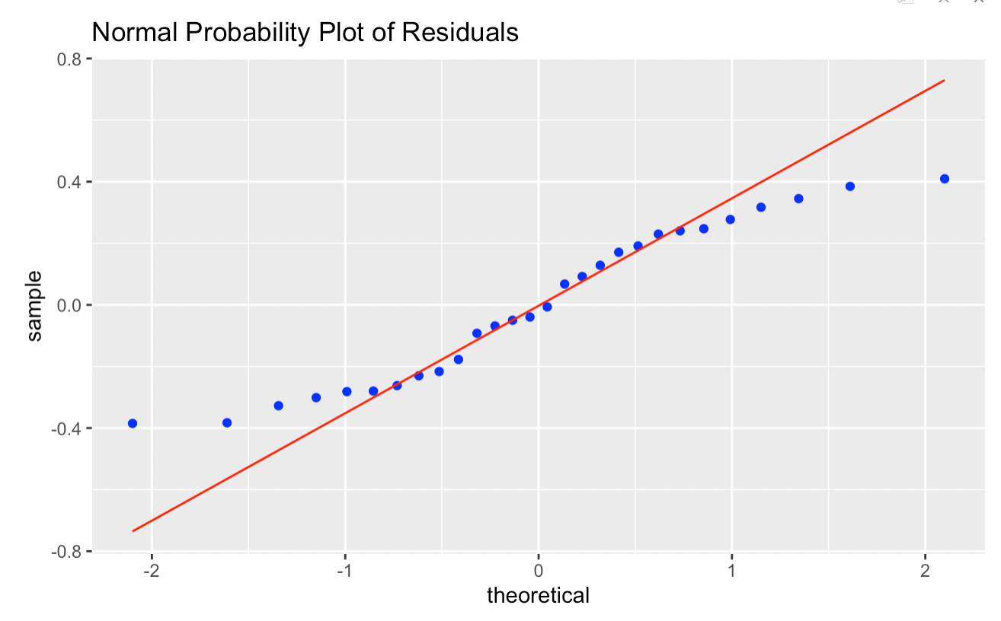
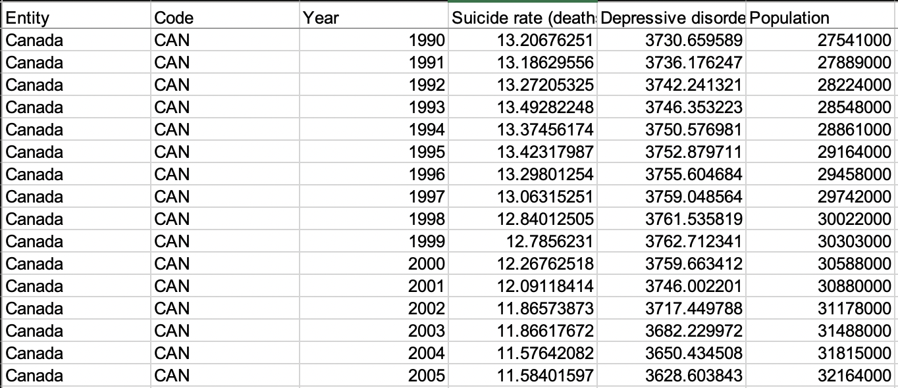
Does suicide rates and depressive disorder rates have any correlation
H0:B=0(Y cannot be expressed as a linear function of X)
HA:B≠0(Y can be expressed as a linear function of X)
Notes:
From using summary(aov(predictsuicide)) we are getting the Fobs value as 185.9 and p value as 0.000000000000236, the degree of freedom as 1. The p value fails to pass the significance level test, hence we can state that the null hypotheses is false and there is a linear relationship between the two values x and y. So, by doing the above test we can confirm our initial perception that the there is a relationship between suicide rates and depressive disorder rates.

Slide 12
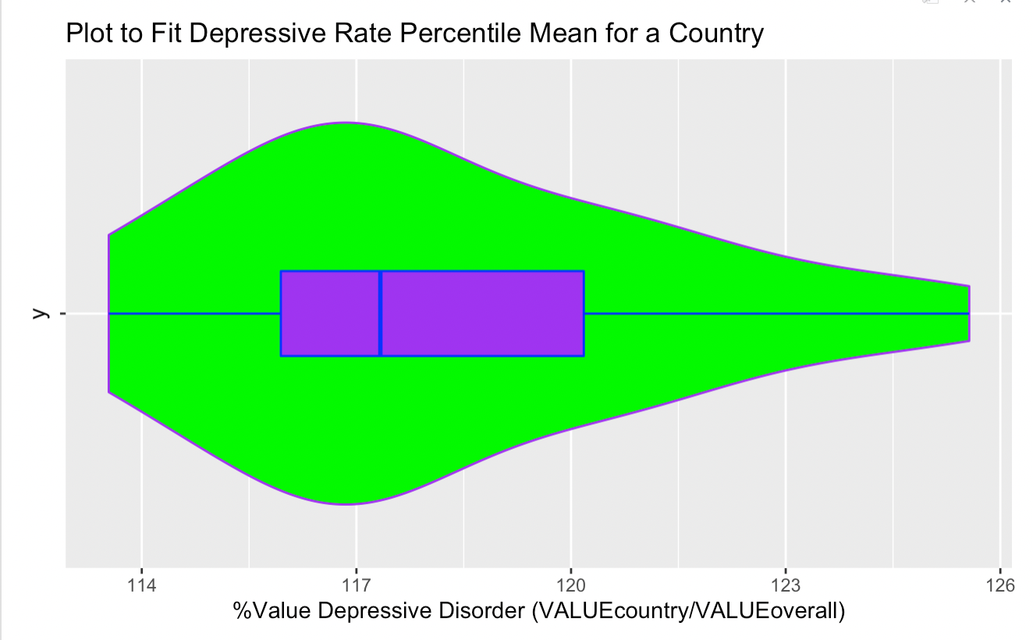
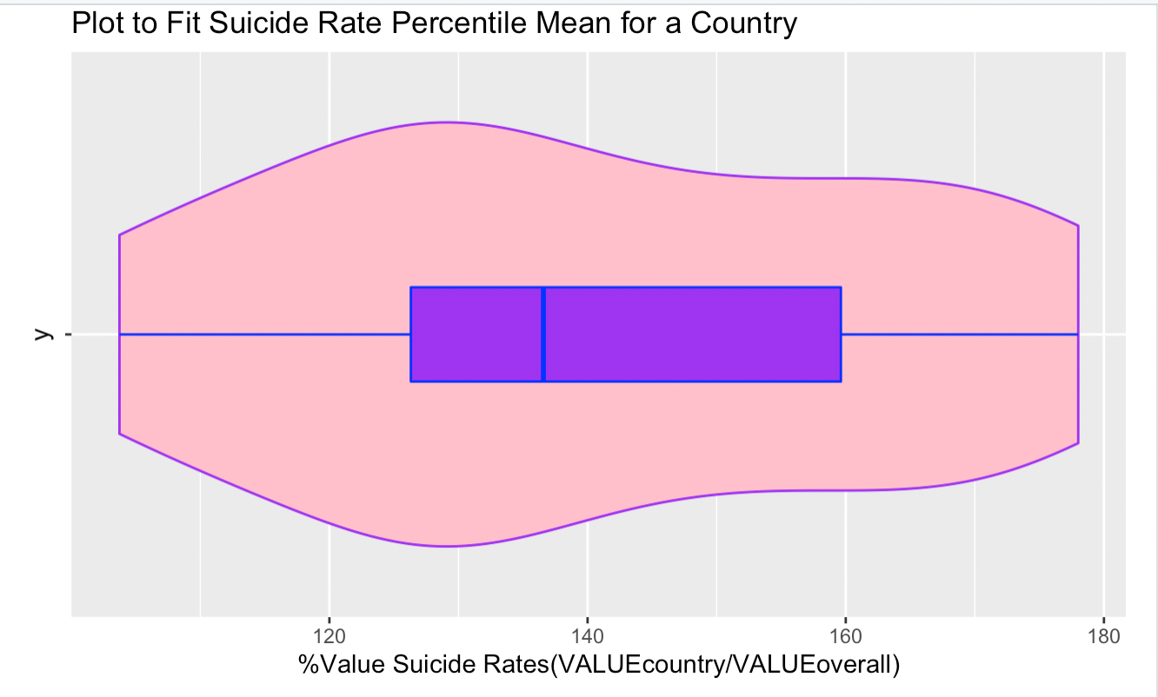
Does suicide rates and depressive disorder rates have any correlation
Notes:
Depressive Disorder Data
Similar to the case of Suicide Rates, we will normalize the depressive data . The calculations below lead the graph for one country over the period of 1990 to 2017. In this case the country choosen is "France", this can be modified by changing the value in the x vector.
From the above observations we have proved a linear relationship between the suicide rates and the depressive disorder rates . Furthermore to better visualize the data we have computed the percentile value for a country from the data available from 1990 to 2017.

Slide 13
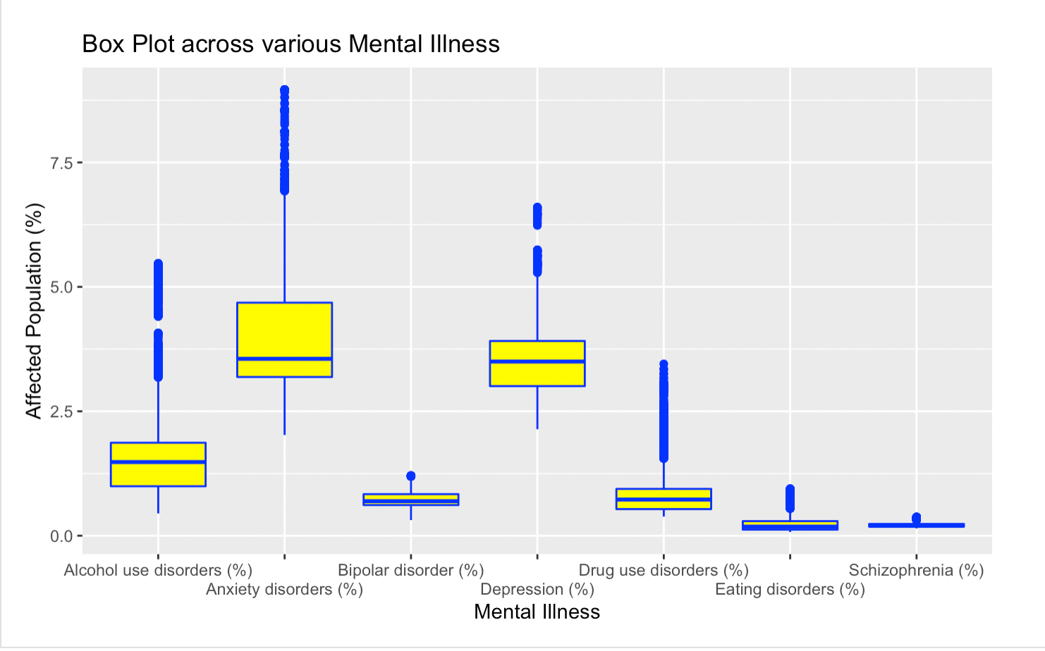
Dataset : Mental Illness
Notes:
> When we look at the above graph we can see that these are the following rankings from high to low of % of Population affected by a mental illness
1) Anxiety disorder
2) Depression
3) Bipolar Disorder
4) Eating Disorder
5) Schizophrenia
> For subtance use these are the following rankings:
1) Alcohol Use
2) Drug Use

Slide 14
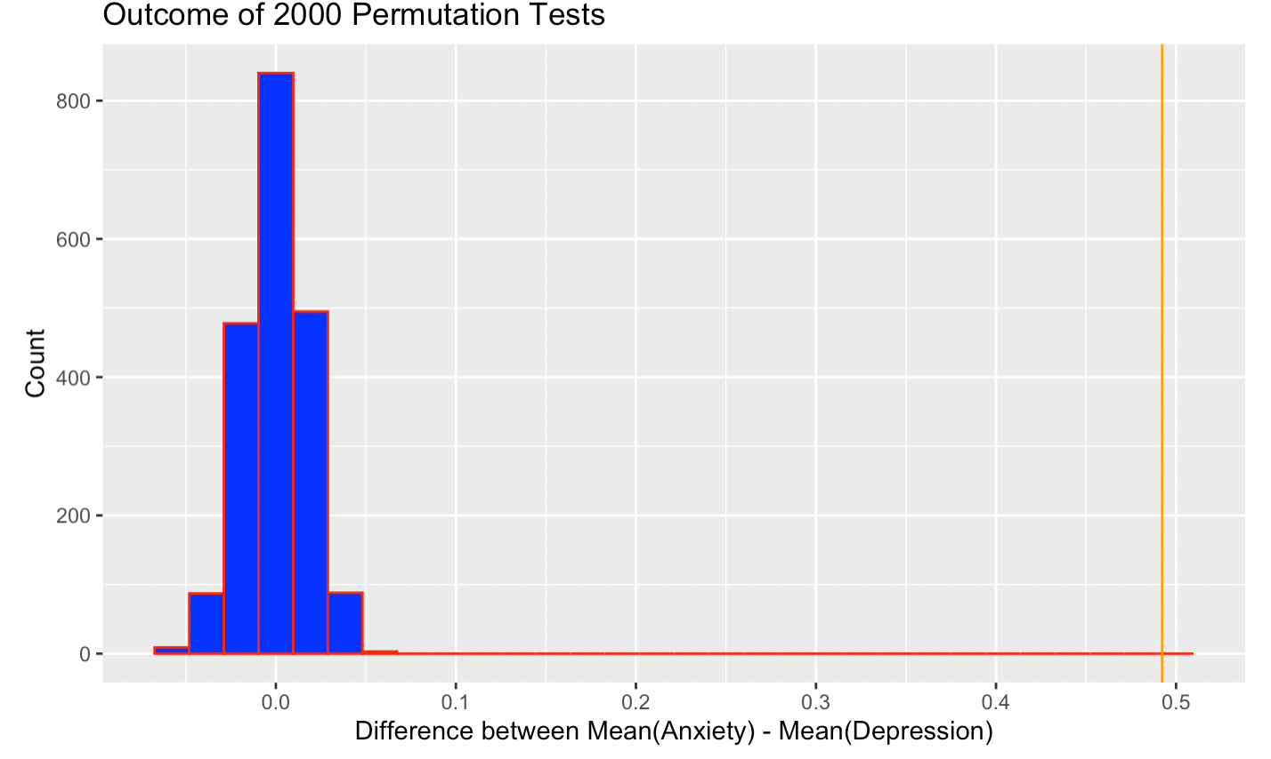
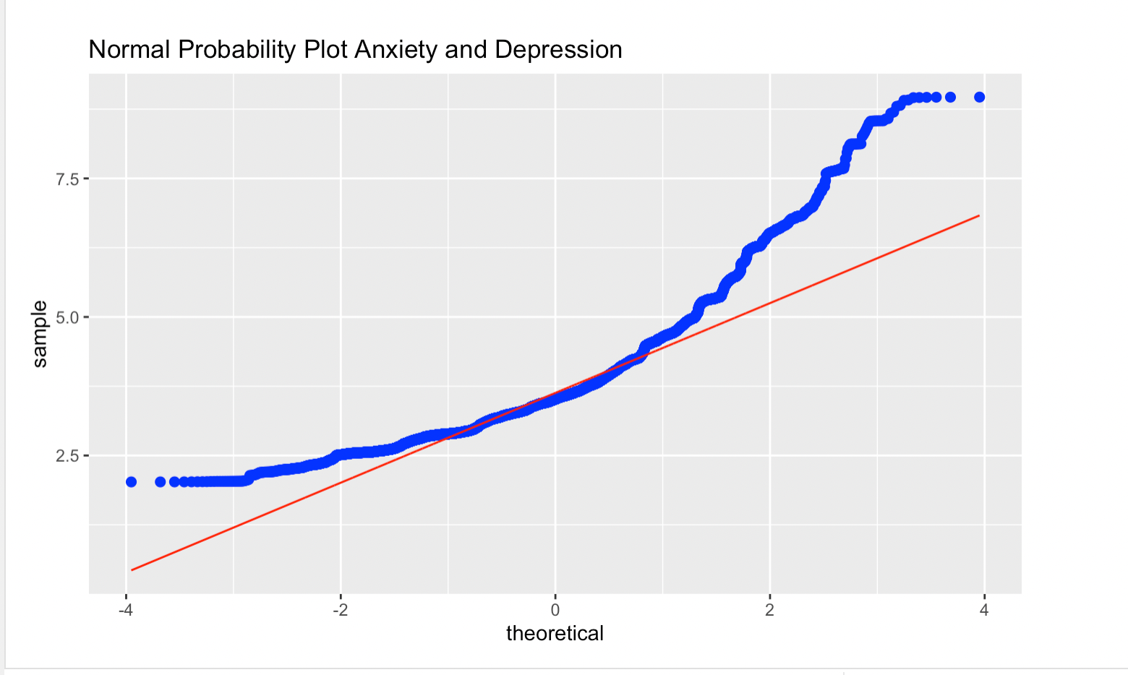
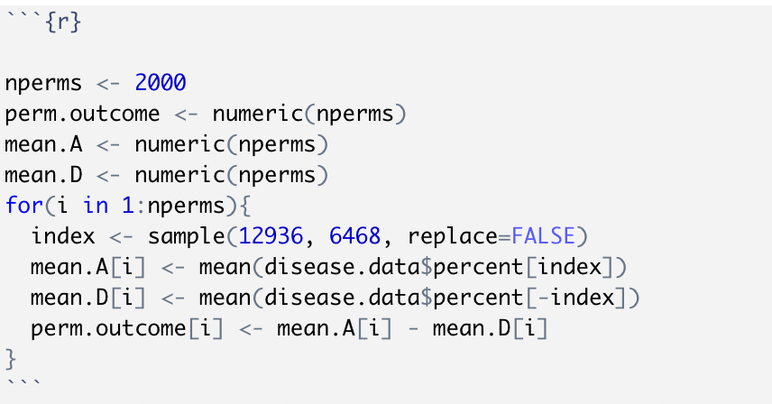
What kind of relationship exists between Anxiety and Depression
H0: Anxiety Percentages and Depression percentages are equal to each other across all the continets
Ha: Anxiety Percentages are higher than depression rates across all the contients
Notes:
After testing to see if Anxiety and Depression follows a normal distribution, we see that it follows a normal distribution, since most of the points are along the straight line, as a result we can do a t-test find the p value and the confidence interval
Because our p-value is <2.2e-16 which is significantly low, so we reject our null hypothesis. As a result we can conclude that Anxiety rates are higher than depression rates

Slide 15
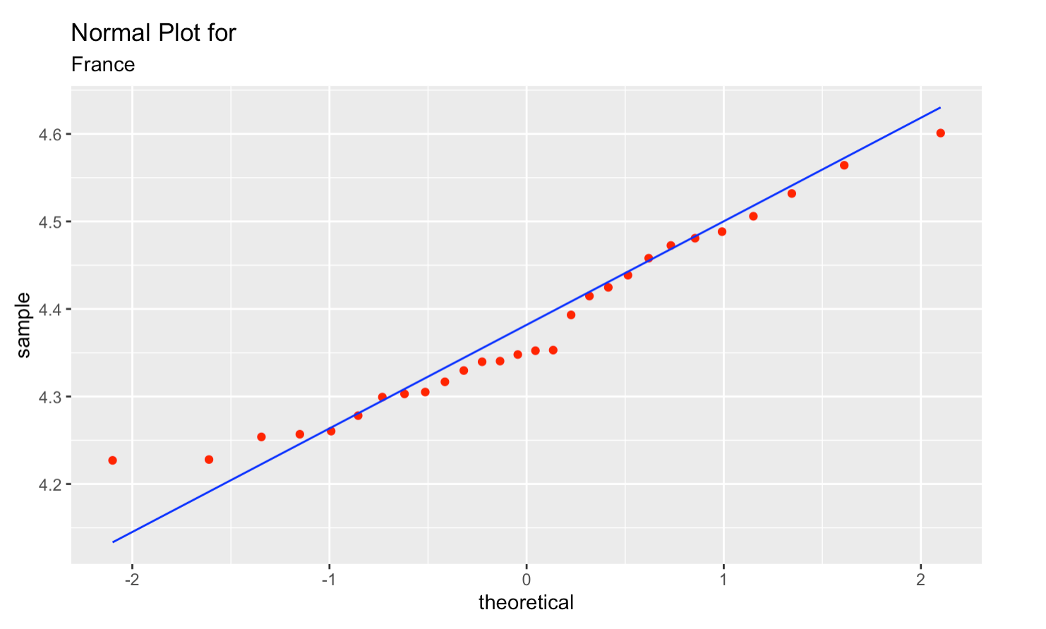
Is the mean of the affected population percentage for the chosen country is equal to the overall population mean for depression?
Notes:
H0: The mean of the afftected population percentage for the chosen country is equal to the overall population mean for depression
H1: The mean of the afftected population percentage for the chosen country is lesser than the overall population mean for depression Welch Two Sample t-test
Since the p-value is approximately zero, we reject the null hypothesis and infer that for the chosen country, the average percentage of population affected via depression is lesser than the world average

Slide 16
References
Elyse, P.by: (2020) 10 happiest countries in the world 2014, Miratel Solutions Inc. Gallup-Healthways Global Well-Being Index. Available at: https://miratelinc.com/blog/10-happiest-countries-in-the-world-2014/ (Accessed: October 13, 2022).
GBD results. Institute for Health Metrics and Evaluation. Available at: https://vizhub.healthdata.org/gbd-results/ [Accessed September 29, 2022].
OECD Education at a Glance , OECD statistics. Available at: https://stats.oecd.org/Index.aspx?datasetcode=EAG (Accessed: October 4, 2022).
International Classification of Diseases (ICD) (no date) World Health Organization. World Health Organization. Available at: https://www.who.int/classifications/classification-of-diseases (Accessed: October 4, 2022).
Open Sourcing Mental Illness, L.T.D. (2016) Mental Health in Tech Survey, Kaggle. OSMH. Available at: https://www.kaggle.com/datasets/osmi/mental-health-in-tech-survey (Accessed: October 15, 2022).

Slide 17
THANK YOU

